Slide 1
Chapter 1
Fundamentals of
the Analysis of Algorithm Efficiency

Slide 2

The Asymptotic Efficiency of Algorithms:
Define the running time of a program T(n) as
a function f(n) of the size of its input, (i.e, T(n) ∞ f(n)).
The running time of an algorithm
increases in the limit, as the size of the input increases without bound.
Let N = {0, 1, 2, …} be the set of natural numbers.
[non-negative integer 0, 1, .. ;
positive integer 1, 2, .. . (traditional way)]

Slide 3

Example 1.1:
The worst-case running time of insertion sort is
T(n) = Ɵ(n²),
as the input size n becomes large enough.
The worse-case running time of merge sort is
T(n) = Ɵ(nlog₂n).

Slide 4
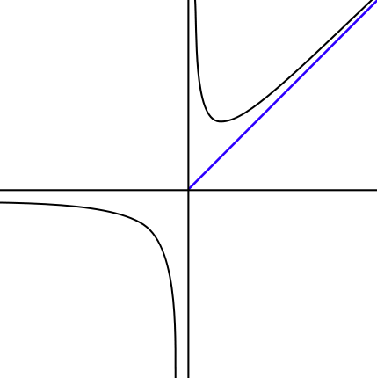
Asymptote: A line whose distance to a given curve tends to zero. An asymptote may or may not intersect its associated curve.
f(n)
The graph of a function with a horizontal (y = 0), vertical (x = 0), and oblique (x = y) asymptotes.

Slide 5
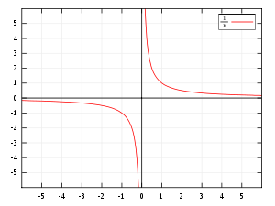

f(x)
graphed on Cartesian coordinates. The x and y-axes are the asymptotes.

Slide 6
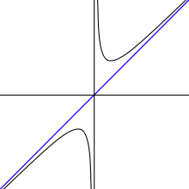

f(x)
In the graph of , the y-axis (x = 0) and the line y= x are both asymptotes. The function f(x) is asymptotic to x = 0 and y = x.

Slide 7
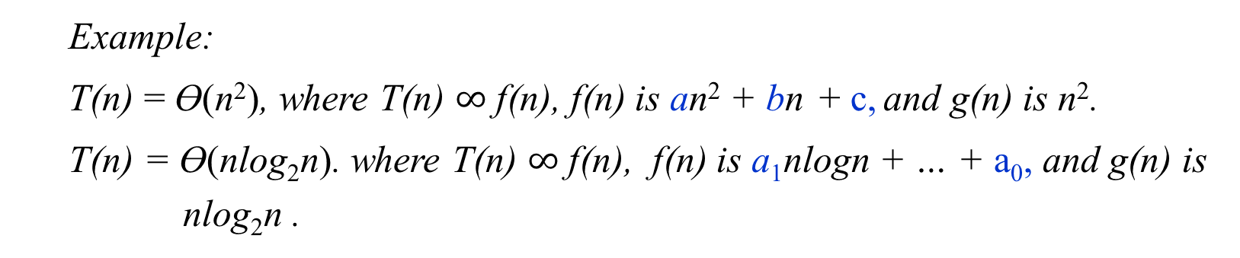
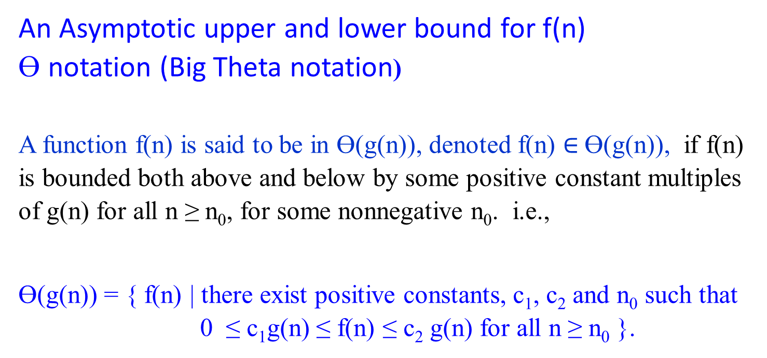
An Asymptotic upper and lower bound for f(n)
Ɵ notation (Big Theta notation)
A function f(n) is said to be in Ɵ(g(n)), denoted f(n) $∈$Ɵ(g(n)), if f(n) is bounded both above and below by some positive constant multiples of g(n) for all n ≥ n₀, for some nonnegative n₀. i.e.,
Ɵ(g(n)) = { f(n) | there exist positive constants, c₁, c₂ and n₀ such that 0 ≤ c₁g(n) ≤ f(n) ≤ c₂ g(n) for all n ≥ n₀ }.
Example:
T(n) = Ɵ(n²), where T(n) $∞$ f(n), f(n) is an² + bn + c, and g(n) is n².
T(n) = Ɵ(nlog₂n). where T(n) $∞$ f(n), f(n) is a₁nlogn + … + a₀, and g(n) is
nlog₂n .

Slide 8
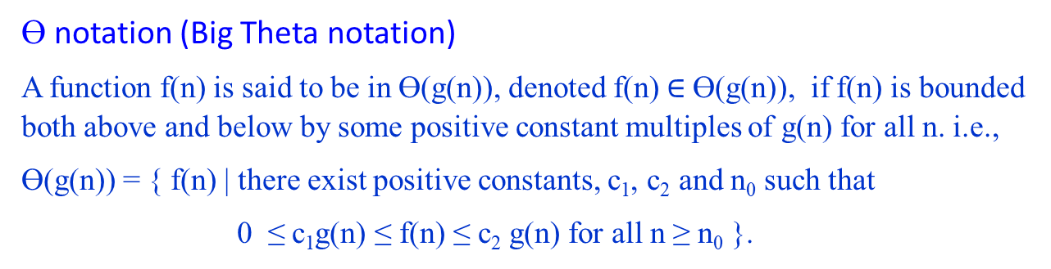

Ɵ notation (Big Theta notation)
A function f(n) is said to be in Ɵ(g(n)), denoted f(n) $∈$Ɵ(g(n)), if f(n) is bounded both above and below by some positive constant multiples of g(n) for all n. i.e.,
Ɵ(g(n)) = { f(n) | there exist positive constants, c₁, c₂ and n₀ such that
0 ≤ c₁g(n) ≤ f(n) ≤ c₂ g(n) for all n ≥ n₀ }.
c₂g(n)
f(n)
c₁g(n)
n₀ f(n) $∈$ Θ(g(n))
Figure 1.2(a) Θ-notation bounds a function to within constant factors. We write f(n) = Θ(g(n)) if there exist positive constant n₀, c₁ and c₂ such that to the right of the minimum possible value n₀, the value of f(n) always lies between c₁g(n) and c₂g(n) inclusive.

Slide 9
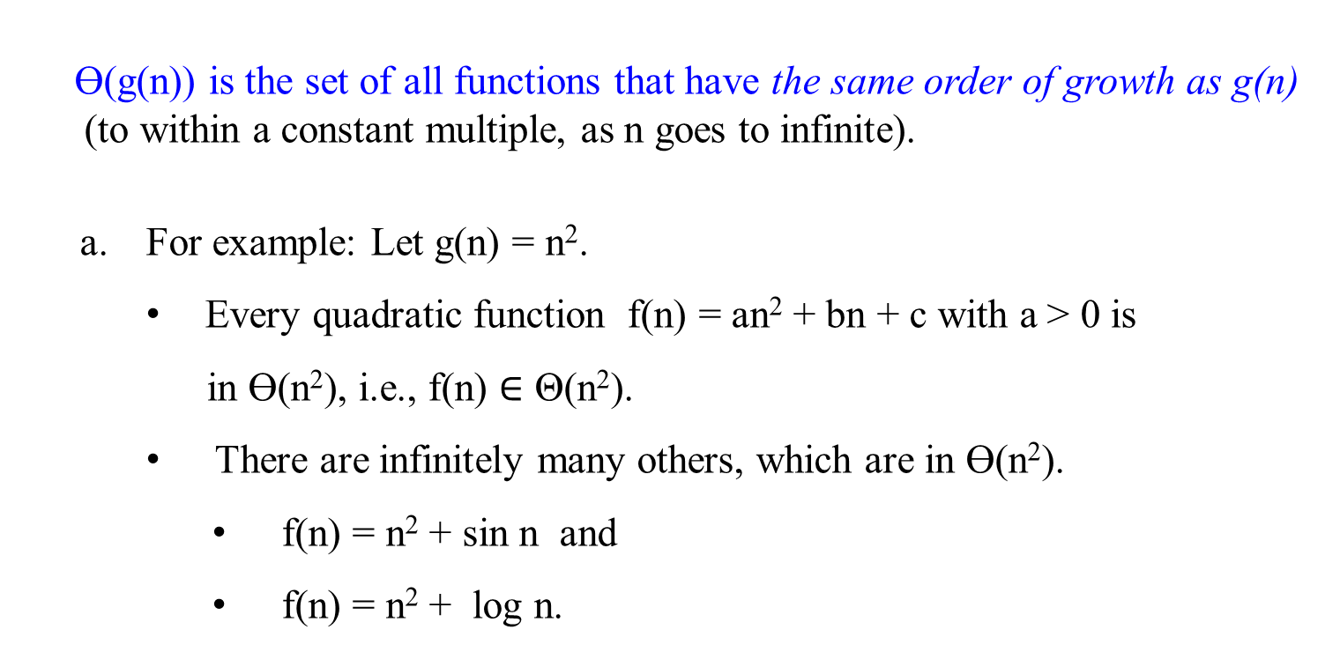
Ɵ(g(n)) is the set of all functions that have the same order of growth as g(n)
(to within a constant multiple, as n goes to infinite).
For example: Let g(n) = n².
Every quadratic function f(n) = an² + bn + c with a > 0 is
in Ɵ(n²), i.e., f(n) $∈$ Θ(n²).
There are infinitely many others, which are in Ɵ(n²).
f(n) = n² + sin n and
f(n) = n² + log n.

Slide 10
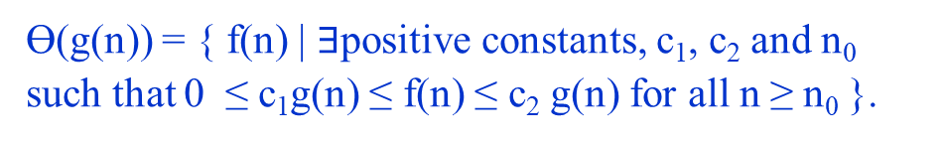
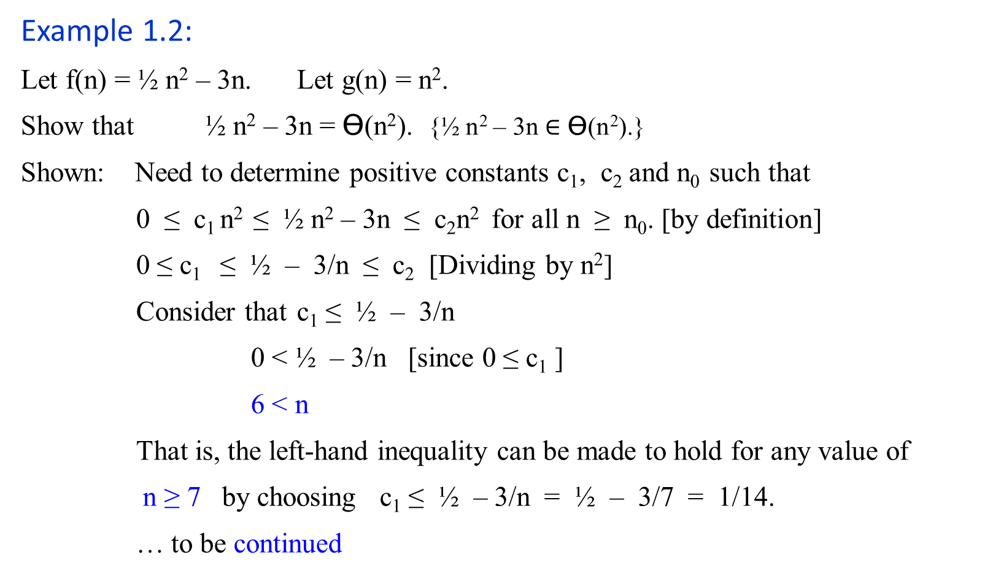
Ɵ(g(n)) = { f(n) | $∃$positive constants, c₁, c₂ and n₀ such that 0 ≤ c₁g(n) ≤ f(n) ≤ c₂ g(n) for all n ≥ n₀ }.
Example 1.2:
Let f(n) = ½ n² – 3n. Let g(n) = n².
Show that ½ n² – 3n = Ɵ(n²). {½ n² – 3n $∈$ Ɵ(n²).}
Shown: Need to determine positive constants c₁, c₂ and n₀ such that
0 ≤ c₁ n² ≤ ½ n² – 3n ≤ c₂n² for all n ≥ n₀. [by definition]
0 ≤ c₁ ≤ ½ – 3/n ≤ c₂ [Dividing by n²]
Consider that c₁ ≤ ½ – 3/n
0 < ½ – 3/n [since 0 ≤ c₁ ]
6 < n
That is, the left-hand inequality can be made to hold for any value of
n ≥ 7 by choosing c₁ ≤ ½ – 3/n = ½ – 3/7 = 1/14.
… to be continued

Slide 11
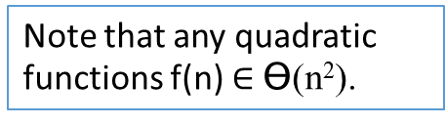
Example 1.2:
Let f(n) = ½ n² – 3n. Let g(n) = n².
Show that ½ n² – 3n = Ɵ(n²).
Shown: Continue …
Consider that ½ – 3/n ≤ c₂.
c₂ ≥ ½ as n is very large.
The right-hand inequality can be made to hold for any value of n ≥ 1 by choosing c₂ ≥ ½ .
Thus, by choosing c₁ = 1/14, c₂ = ½ and n₀ = 7, we verify that ½n² – 3n = Ɵ(n²). QED.
Note that any quadratic functions f(n) $∈$ Ɵ(n²).
Note that 1) Other choices for the constants exits.
2) A different function belonging to would usually require different constants.

Slide 12
Let f(n) = ½ n² – 3n. Let g(n) = n². c₁ = 1/14 = 0.071428571
n | ½ n² – 3n | n² | 0.07 n² | 0.5 n²
0 | 0 | 0 | 0 | 0
1 | -2.5 | 1 | 0.07 | 0.5
2 | -4 | 4 | 0.28 | 2
4 | -4 | 16 | 1.12 | 8
5 | -2.5 | 25 | 1.75 | 12.5
6 | 0 | 36 | 2.52 | 18
7 | 3.5 | 49 | 3.43 | 24.5
8 | 8 | 64 | 4.48 | 32
9 | 13.5 | 81 | 5.67 | 40.5
10 | 20 | 100 | 7 | 50
11 | 27.5 | 121 | 8.47 | 60.5
12 | 36 | 144 | 10.08 | 72
13 | 45.5 | 169 | 11.83 | 84.5
14 | 56 | 196 | 13.72 | 98
15 | 67.5 | 225 | 15.75 | 112.5
16 | 80 | 256 | 17.92 | 128
17 | 93.5 | 289 | 20.23 | 144.5
18 | 108 | 324 | 22.68 | 162
19 | 123.5 | 361 | 25.27 | 180.5
20 | 140 | 400 | 28 | 200
25 | 237.5 | 625 | 43.75 | 312.5
30 | 360 | 900 | 63 | 450
40 | 680 | 1600 | 112 | 800
50 | 1100 | 2500 | 175 | 1250
60 | 1620 | 3600 | 252 | 1800
70 | 2240 | 4900 | 343 | 2450
80 | 2960 | 6400 | 448 | 3200
90 | 3780 | 8100 | 567 | 4050
100 | 4700 | 10000 | 700 | 5000
200 | 19400 | 40000 | 2800 | 20000
500 | 123500 | 250000 | 17500 | 125000
1000 | 497000 | 1000000 | 70000 | 500000
5000 | 12485000 | 25000000 | 1750000 | 12500000
10000 | 49970000 | 100000000 | 7000000 | 50000000
20000 | 199940000 | 400000000 | 28000000 | 200000000
50000 | 1249850000 | 2500000000 | 175000000 | 1250000000
100000 | 4999700000 | 10000000000 | 700000000 | 5000000000

Slide 13

Let f(n) = ½ n² – 3n. Let g(n) = n². c₁ = 1/14 = 0.071428571 and c₂ = ½
n | ½ n² – 3n | n² | 0.07 n² | 0.5 n²
0 | 0 | 0 | 0 | 0
1 | -2.5 | 1 | 0.07 | 0.5
2 | -4 | 4 | 0.28 | 2
4 | -4 | 16 | 1.12 | 8
5 | -2.5 | 25 | 1.75 | 12.5
6 | 0 | 36 | 2.52 | 18
7 | 3.5 | 49 | 3.43 | 24.5
8 | 8 | 64 | 4.48 | 32
9 | 13.5 | 81 | 5.67 | 40.5
10 | 20 | 100 | 7 | 50
11 | 27.5 | 121 | 8.47 | 60.5
12 | 36 | 144 | 10.08 | 72
13 | 45.5 | 169 | 11.83 | 84.5
14 | 56 | 196 | 13.72 | 98
15 | 67.5 | 225 | 15.75 | 112.5
16 | 80 | 256 | 17.92 | 128
17 | 93.5 | 289 | 20.23 | 144.5
18 | 108 | 324 | 22.68 | 162
19 | 123.5 | 361 | 25.27 | 180.5
20 | 140 | 400 | 28 | 200

Slide 14
Let f(n) = ½ n² – 3n. Let g(n) = n². c₁ = 1/14 = 0.071428571
n | ½ n² – 3n | n² | 0.07 n² | 0.5 n²
20 | 140 | 400 | 28 | 200
25 | 237.5 | 625 | 43.75 | 312.5
30 | 360 | 900 | 63 | 450
40 | 680 | 1600 | 112 | 800
50 | 1100 | 2500 | 175 | 1250
60 | 1620 | 3600 | 252 | 1800
70 | 2240 | 4900 | 343 | 2450
80 | 2960 | 6400 | 448 | 3200
90 | 3780 | 8100 | 567 | 4050
100 | 4700 | 10000 | 700 | 5000
200 | 19400 | 40000 | 2800 | 20000
500 | 123500 | 250000 | 17500 | 125000
1000 | 497000 | 1000000 | 70000 | 500000
5000 | 12485000 | 25000000 | 1750000 | 12500000
10000 | 49970000 | 100000000 | 7000000 | 50000000
20000 | 199940000 | 400000000 | 28000000 | 200000000
50000 | 1249850000 | 2500000000 | 175000000 | 1250000000
100000 | 4999700000 | 10000000000 | 700000000 | 5000000000

Slide 15
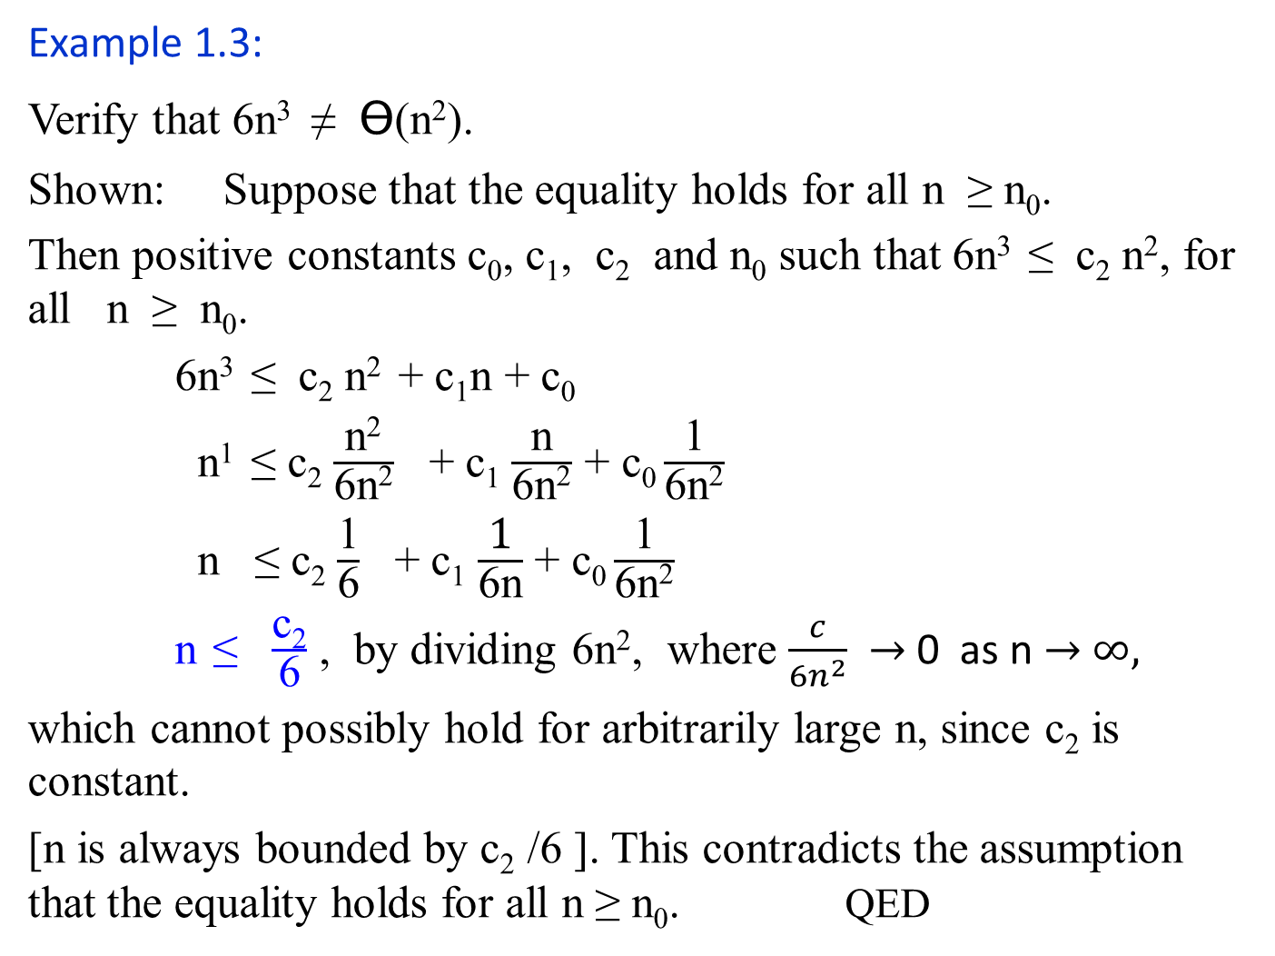
Example 1.3:
Verify that 6n³ ≠ Ɵ(n²).
Shown: Suppose that the equality holds for all n ≥ n₀.
Then positive constants c₀, c₁, c₂ and n₀ such that 6n³ ≤ c₂ n², for all n ≥ n₀.
6n³ ≤ c₂ n² + c₁n + c₀
n¹ ≤ c₂ $\frac{\text{n}\text{2}}{\text{6}\text{n}\text{2}}$ + c₁ $\frac{\text{n}}{\text{6}\text{n}\text{2}}$ + c₀ $\frac{\text{1}}{\text{6}\text{n}\text{2}}$
n ≤ c₂ $\frac{\text{1}}{\text{6}}$ + c₁ $\frac{\text{1}}{\text{6}\text{n}}$ + c₀ $\frac{\text{1}}{\text{6}\text{n}\text{2}}$
n ≤ $\frac{\text{c}\text{2}}{\text{6}}$ , by dividing 6n², where $\frac{c}{{6n}^{2}}$ $→$ 0 as n $→$ $∞,$
which cannot possibly hold for arbitrarily large n, since c₂ is constant.
[n is always bounded by c₂ /6 ]. This contradicts the assumption that the equality holds for all n ≥ n₀. QED
Ɵ(g(n)) = { f(n) | $∃$positive constants, c₁, c₂ and n₀ such that 0 ≤ c₁g(n) ≤ f(n) ≤ c₂ g(n) for all n ≥ n₀ }.

Slide 16
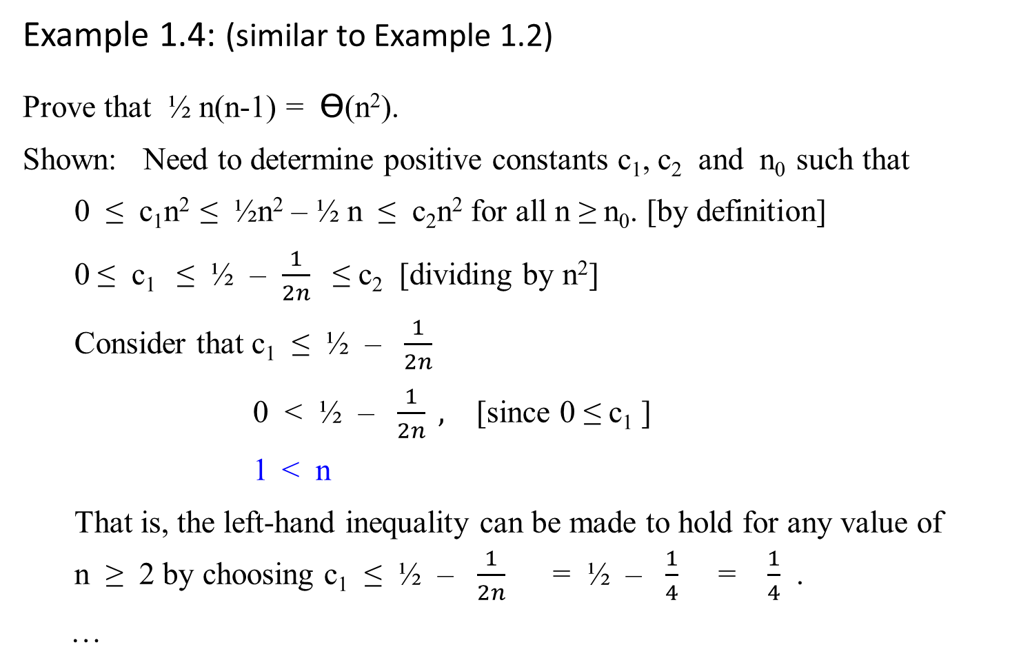
Example 1.4: (similar to Example 1.2)
Prove that ½ n(n-1) = Ɵ(n²).
Shown: Need to determine positive constants c₁, c₂ and n₀ such that
0 ≤ c₁n² ≤ ½n² – ½ n ≤ c₂n² for all n ≥ n₀. [by definition]
0 ≤ c₁ ≤ ½ – $\frac{1}{2n}$ ≤ c₂ [dividing by n²]
Consider that c₁ ≤ ½ – $\frac{1}{2n}$
0 < ½ – $\frac{1}{2n} ,$ [since 0 ≤ c₁ ]
1 < n
That is, the left-hand inequality can be made to hold for any value of n ≥ 2 by choosing c₁ ≤ ½ – $\frac{1}{2n}$ = ½ – $\frac{1}{4}$ = $\frac{1}{4}$ .
…

Slide 17
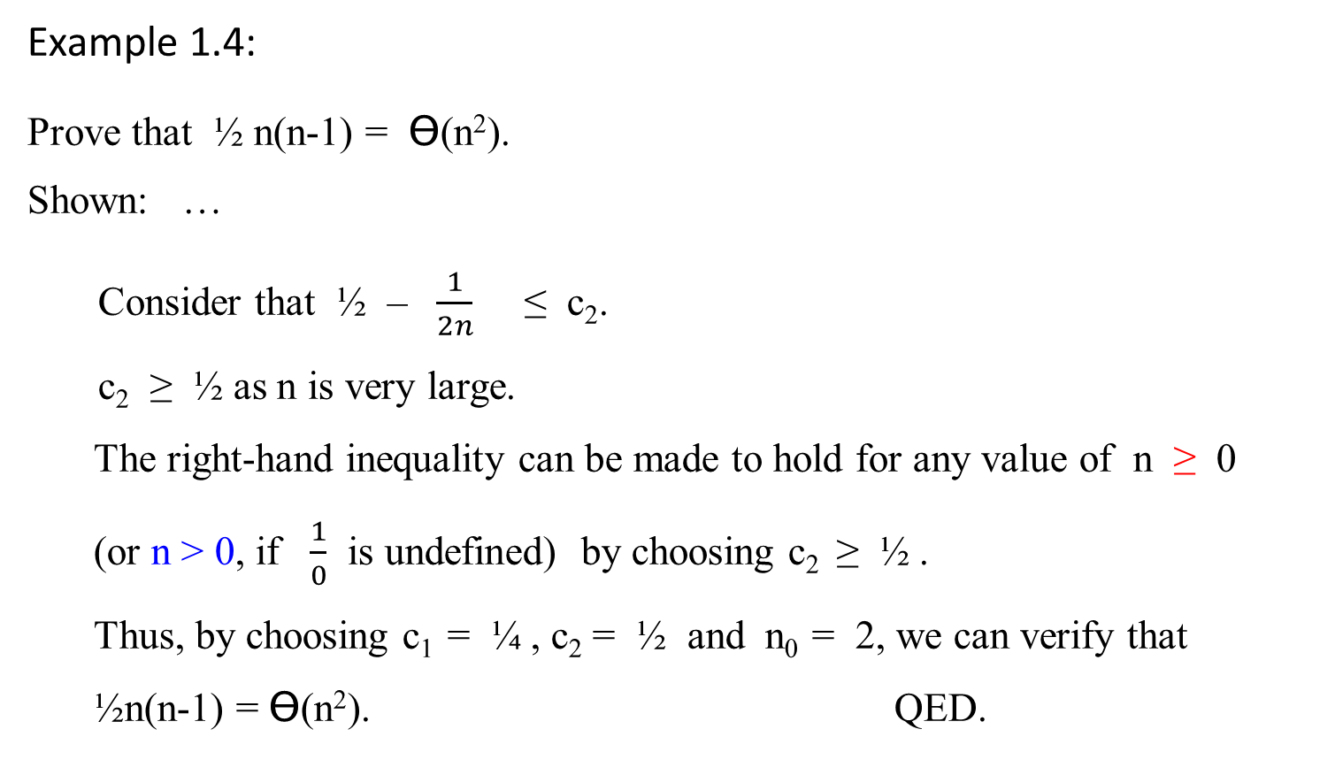
Example 1.4:
Prove that ½ n(n-1) = Ɵ(n²).
Shown: …
Consider that ½ – $\frac{1}{2n}$ ≤ c₂.
c₂ ≥ ½ as n is very large.
The right-hand inequality can be made to hold for any value of n ≥ 0
(or n > 0, if $\frac{1}{0}$ is undefined) by choosing c₂ ≥ ½ .
Thus, by choosing c₁ = ¼ , c₂ = ½ and n₀ = 2, we can verify that ½n(n-1) = Ɵ(n²). QED.

Slide 18
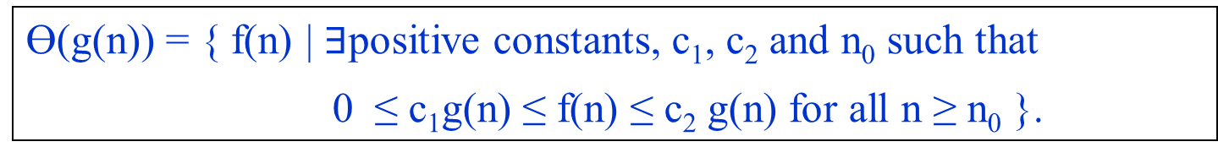

An Asymptotic upper bound for f(n)
O-notation (Big Oh notation, sometimes, Oh notation)
Big-oh of g of n
Definition:
A function f(n) is said to be in O(g(n)), denoted f(n) $∈$ O(g(n)), if f(n) is bounded above by some constant multiple of g(n) for all n ≥ n₀, for some nonnegative n₀. i.e.,
O(g(n)) = {f(n) | there exist positive constants c and n₀ such that 0 ≤ f(n) ≤ cg(n) for all n ≥ n₀.}
Ɵ(g(n)) = { f(n) | $∃$positive constants, c₁, c₂ and n₀ such that
0 ≤ c₁g(n) ≤ f(n) ≤ c₂ g(n) for all n ≥ n₀ }.

Slide 19

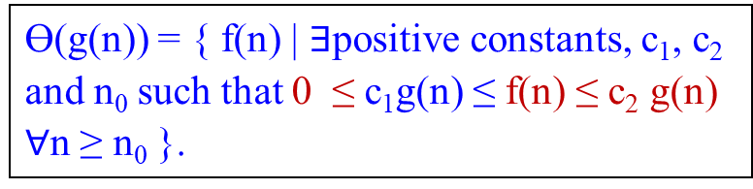
An Asymptotic upper bound for f(n)
O-notation (Big Oh notation)
Big-oh of g of n
For a given complexity function g(n),
O(g(n)) = {f(n) | there exist positive constants c and n₀ such that
0 ≤ f(n) ≤ cg(n) for all n ≥ n₀.}
Ɵ(g(n)) = { f(n) | $∃$positive constants, c₁, c₂ and n₀ such that 0 ≤ c₁g(n) ≤ f(n) ≤ c₂ g(n) $∀$n ≥ n₀ }.
cg(n)
f(n)
n₀ f(n) = O(g(n)) where c and n₀ are positive integer 1, 2, …
Figure 1.2. (b) O-notation gives an upper bound for a function to within a constant factor.
If f(n) $∈$ O(g(n)), we say that f(n) is big O of g(n).

Slide 20
We say that “big O” puts an asymptotic upper bound on a complexity function.

Slide 21
Example 1.5:
Prove that 100n + 5 = O(n²).
Proof: 100n + 5 ≤ 100n + n (for all n ≥ 5)
= 101n ≤ 101 n²
Thus, c = 101 and n₀ = 5. g(n) = n² .
Note that the definition gives us many choice for selecting constants c and n₀. For example:
100n + 5 ≤ 100n + 5n (for all n ≥ 1)
= 105n ≤ 105 n²
Thus, c = 105 and n₀ = 1. g(n) = n² .
Thus, 0 ≤ f(n) ≤ cg(n) for all n ≥ n₀ yields 0 ≤ 100n + 5 ≤ 105 n² , for all n₀ ≥ 1

Slide 22
Examples 1.6:
O(g(n)) is the set of all functions with a smaller or same order of growth as g(n) (to within a constant multiple, as n goes to infinity).
n ε O(n²). 100n + 5 ε O(n²). ½ n(n-1) ε O(n²).
On the other hand,
n³ ≠ O(n²). 0.00001n³ ≠ O(n²). n⁴ + n + 1 ≠ O(n²).

Slide 23
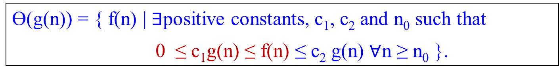

An Asymptotic lower bound on a function
Ω-notation (Big-omega of g of n)
Definition:
A function f(n) is said to be in Ω(g(n)), denoted f(n) $∈$ Ω(g(n)), if f(n) is bounded below by some constant multiple of g(n) for all n ≥ n₀, for some nonnegative n₀. i.e.,
Ω(g(n)) = { f(n) | there exist positive constants c and n₀ such that
0 ≤ cg(n) ≤ f(n) for all n ≥ n₀ }.
Ɵ(g(n)) = { f(n) | $∃$positive constants, c₁, c₂ and n₀ such that
0 ≤ c₁g(n) ≤ f(n) ≤ c₂ g(n) $∀$n ≥ n₀ }.

Slide 24

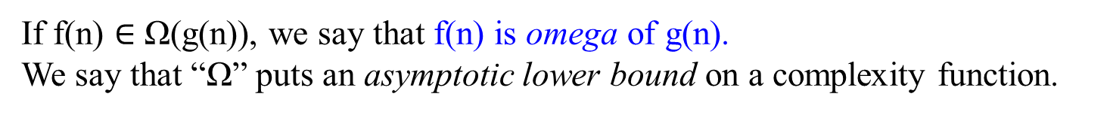
Figure 1.2. (c). Ω-notation gives a lower bound for a function to within a constant factor.
We write f(n) = Ω(g(n)) if there are positive constants n₀ and c such that to the right of n₀, the value of f(n) always lies on or above cg(n).
f(n)
asymptote
cg(n)
n₀ f(n) = Ω(g(n))
If f(n) $∈$ Ω(g(n)), we say that f(n) is omega of g(n).
We say that “Ω” puts an asymptotic lower bound on a complexity function.

Slide 25
Example 1.7:
Prove that n³ = Ω(n²).
Proof: 0 ≤ n² ≤ n³ , for all n ≥ 0.
That is we can select c = 1 and n₀ = 0.
Example 1.8:
Ω(g(n)) stands for the set of all functions with a larger or same order of growth as g(n) (to within a constant multiple, as n goes to infinity).
n³ ε Ω (n²). ½ n(n-1) ε Ω (n²). But 100n + 5 ≠ Ω (n²).

Slide 26
Theorem 1.2:
For any two functions f(n) and g(n), we have f(n) = Ɵ(g(n)) if, and only if f(n) = O(g(n)) and f(n) = Ω(g(n)).
Proof: Followed by their definitions.
Example 1.9:
Our proof that an² + bn + c = Ɵ(n²) for any constant a, b and c, where a > 0, immediately implies that an² + bn + c = Ω(n²) and an² + bn + c = O(n²).

Slide 27
Insertion Sort
Algorithm Insertion-Sort(A[0..n-1])
//sorts a given array by insertion sort
//Input: An array A[0..n-1] of n orderable elements
//Output: Array A[0..n-1] sorted in nondecreasing order
for (i ← 1 to n – 1)
do {key ← A[i]
//Insert A[j] into the sorted sequence A[1 .. j-1].
j ← i – 1
while (j ≥ 0 and A[j] > key) do { A[j+1] ← A[j]
j ← j – 1 } //end doWhile
A[j+1] ← key; } //end doFor

Slide 28

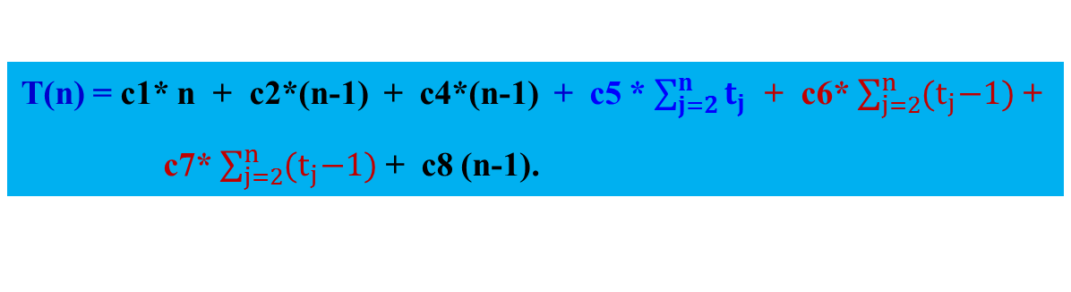
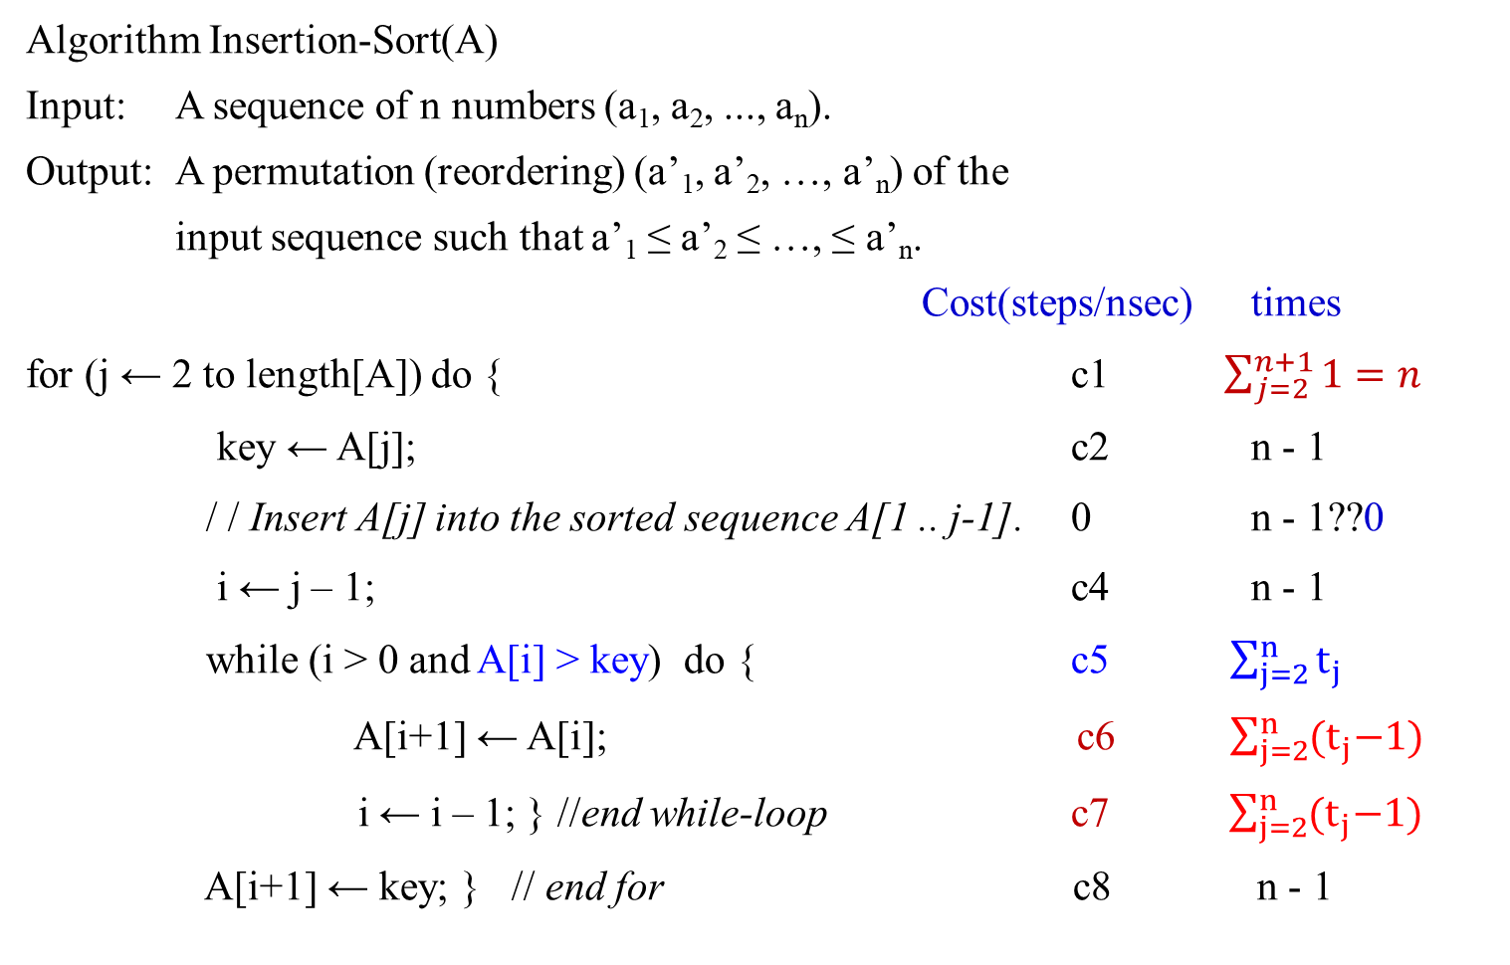
T(n) = c1* n + c2*(n-1) + c4*(n-1) + c5 * $\sum_{j=2}^{n}{t_{j}}$ + c6* $\sum_{j=2}^{n}{{(t}_{j}−1)}$ +
c7* $\sum_{j=2}^{n}{{(t}_{j}−1)}$ + c8 (n-1).
Algorithm Insertion-Sort(A)
Input: A sequence of n numbers (a₁, a₂, ..., a_{n}).
Output: A permutation (reordering) (a’₁, a’₂, …, a’_{n}) of the
input sequence such that a’₁ ≤ a’₂ ≤ …, ≤ a’_{n}.
Cost(steps/nsec) times
for (j ← 2 to length[A]) do { c1 $\sum_{j=2}^{n+1}{1=n}$
key ← A[j]; c2 n - 1
/ / Insert A[j] into the sorted sequence A[1 .. j-1]. 0 n - 1??0
i ← j – 1; c4 n - 1
while (i > 0 and A[i] > key) do { c5 $\sum_{j=2}^{n}{t_{j}}$
A[i+1] ← A[i]; c6 $\sum_{j=2}^{n}{{(t}_{j}−1)}$
i ← i – 1; } //end while-loop c7 $\sum_{j=2}^{n}{{(t}_{j}−1)}$
A[i+1] ← key; } // end for c8 n - 1

Slide 29

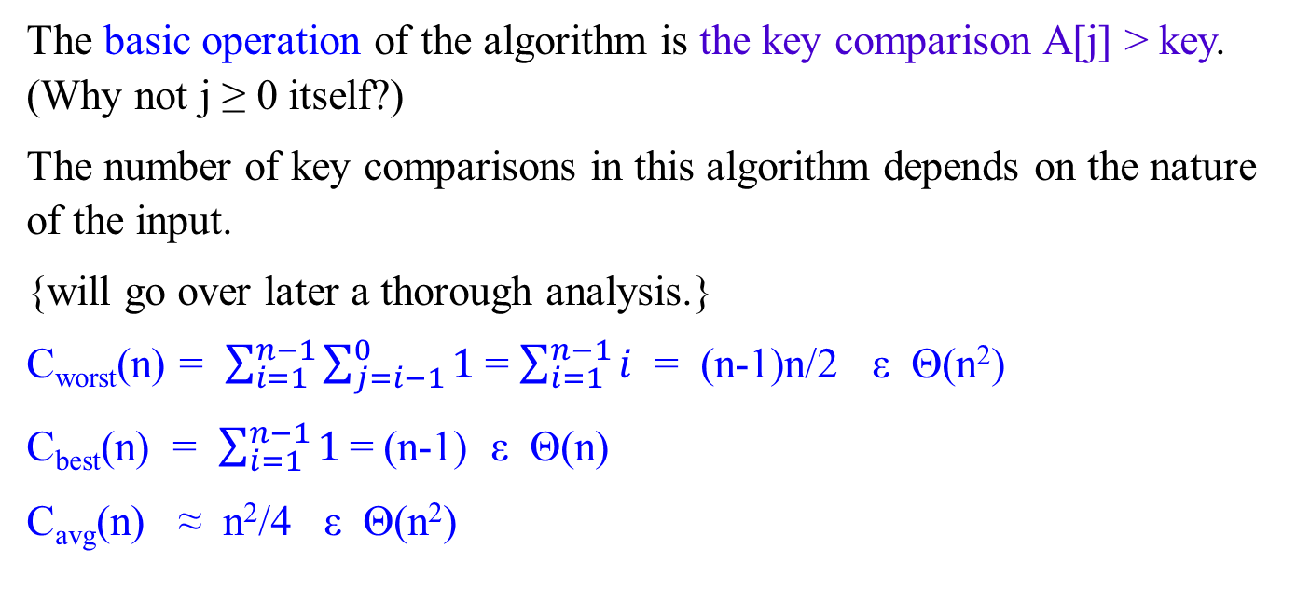
The basic operation of the algorithm is the key comparison A[j] > key. (Why not j ≥ 0 itself?)
The number of key comparisons in this algorithm depends on the nature of the input.
{will go over later a thorough analysis.}
C_{worst}(n) = $\sum_{i=1}^{n−1}{\sum_{j=i−1}^{0}{1}}$= $\sum_{i=1}^{n−1}{i}$ = (n-1)n/2 ε Θ(n²)
C_{best}(n) = $\sum_{i=1}^{n−1}{1}$= (n-1) ε Θ(n)
C_{avg}(n) ≈ n²/4 ε Θ(n²)
for i ← 1 to n - 1
do { key ← A[i]
j ← i – 1
while j ≥ 0 and A[j] > key
do { A[j+1] ← A[j];
j ← j – 1; }
A[j+1] ← key; }

Slide 30

Using Limits for Comparing Orders of Growth
A convenient method for comparing the orders of growth of two specific functions is based on computing the limit of the ratio of two functions in question.
Three principal cases may arise:
f(n) 0 implies that f(n) has a smaller order of growth than g(n)
lim ---- = c > 0 implies that f(n) has the same order of growth as g(n)
n → ∞ g(n) ∞ implies that f(n) has a larger order of growth than g(n).
Note that
The first two cases mean that f(n) ε O(g(n)).
The second case means that f(n) ε Ɵ(g(n))
The last two mean that f(n) ε Ω(g(n)).

Slide 31

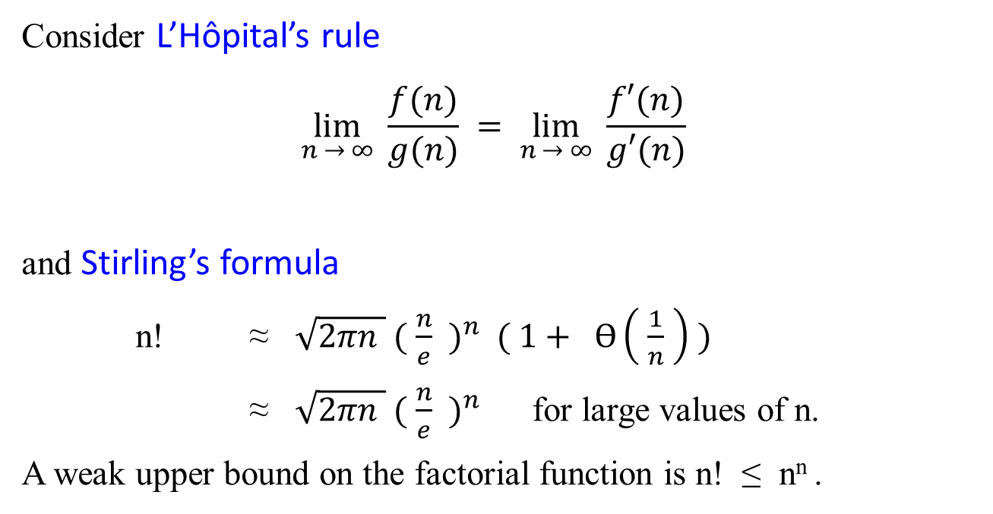
Consider L’Hôpital’s rule
$$\lim_{n → ∞}{\frac{f(n)}{g(n)}} = \lim_{n → ∞}{ \frac{f′(n)}{g′(n)}}$$
and Stirling’s formula
n! ≈ $\sqrt{2πn } {( \frac{n}{e} )}^{n} ( 1+ Ɵ\left( \frac{1}{n} \right) )$
≈ $\sqrt{2πn } {( \frac{n}{e} )}^{n}$ for large values of n.
A weak upper bound on the factorial function is n! ≤ n^{n} .

Slide 32

Examples: using the limit-based approach to comparing orders of growth of two functions:
Example 1.11: Compare the orders of growth of ½ n(n-1) and n².
$\lim_{n → ∞}{ \frac{ \frac{1}{2} n(n−1)}{ n^{2}} }$= $\frac{1}{2} \lim_{n → ∞}{\frac{n^{2}−n}{n^{2}}}$
= $\frac{1}{2} \lim_{n → ∞}{ ( 1− \frac{1}{n} )}$
= ½.
Since the limit is equal to a positive constant, the function have the same order of growth or, symbolically, ½ n(n-1) ε Ɵ(n²).

Slide 33

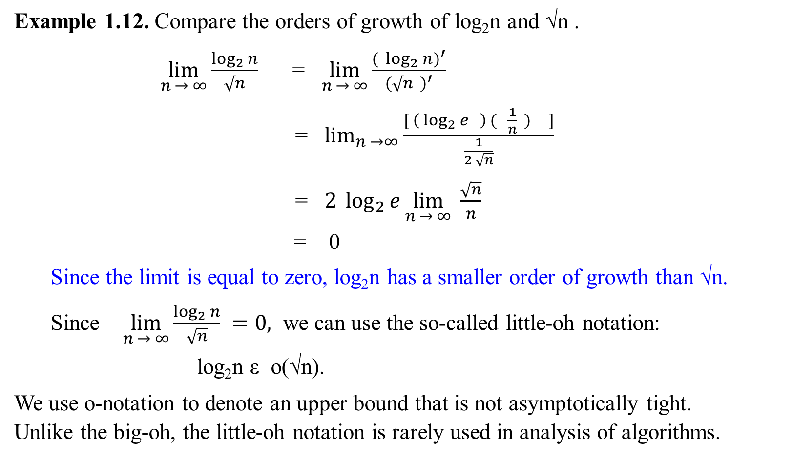
$${( \log_{2}{n})}^{′}$$
= $\left( \log_{2}{e} \right) ( \frac{n′}{n} )$
=$\left( \log_{2}{e} \right) ( \frac{1}{n} )$
Example 1.12. Compare the orders of growth of log₂n and √n .
$\lim_{n → ∞}{\frac{\log_{2}{n}}{\sqrt{n}}}$ = $\lim_{n → ∞}{\frac{{( \log_{2}{n})}^{′}}{{(\sqrt{n } )}^{′}}}$
= $\lim_{n →∞}{\frac{[ \left( \log_{2}{e} \right) ( \frac{1}{n} ) ]}{\frac{1}{2 \sqrt{n}}}}$
= $2 \log_{2}{e}\lim_{n → ∞}{\frac{\sqrt{n}}{n}}$
= 0
Since the limit is equal to zero, log₂n has a smaller order of growth than √n.
Since $\lim_{n → ∞}{\frac{\log_{2}{n}}{\sqrt{n}}} =0,$ we can use the so-called little-oh notation:
log₂n ε o(√n).
We use o-notation to denote an upper bound that is not asymptotically tight. Unlike the big-oh, the little-oh notation is rarely used in analysis of algorithms.

Slide 34
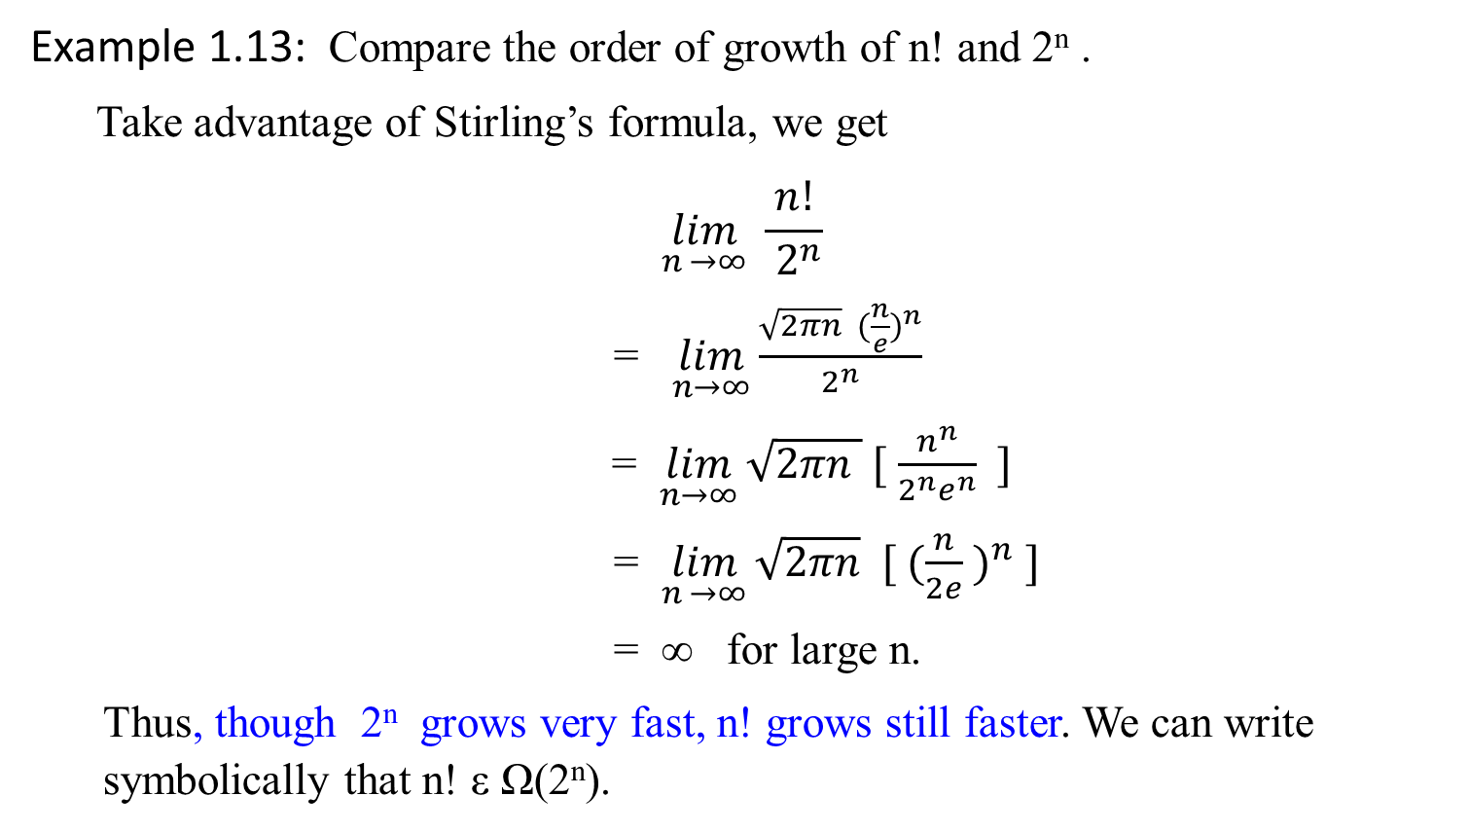
Example 1.13: Compare the order of growth of n! and 2^{n} .
Take advantage of Stirling’s formula, we get
$$\lim_{n →∞}{\frac{ n! }{{ 2}^{n}}}$$
= $\lim_{n→∞}{\frac{\sqrt{2πn} ({\frac{n}{e})}^{n}}{2^{n}}}$
= $\lim_{n→∞}{\sqrt{2πn } [ \frac{n^{n}}{2^{n}e^{n}} ]}$
= $\lim_{n →∞}{\sqrt{2πn} [ ({\frac{n}{2e} )}^{n} ]}$
= ∞ for large n.
Thus, though 2^{n} grows very fast, n! grows still faster. We can write symbolically that n! ε Ω(2^{n}).

Slide 35
Class | Name | Comments / Table 1.2: Basis Efficiency Class
1 | Constant
log n | logarithmic | Result of cutting a problem’s size by a constant factor on each iteration of the algorithm. Binary search
n | linear | Algorithms that scan a list of size n belong to this class. Sequential search
nlogn | n-log-n | Many of divide-and-conquer algorithms, such as, merge sort, quicksort…
n² | quadratic | Two embedded loops algorithms; insertion sort; certain operation on n-by-n matrices.
n³ | cubic | Three embedded loops algorithms. Several nontrivial algorithms from linear algebra, such as multiply two n-by-n matrices by the definition-based algorithm.
2^{n} | exponential | Algorithms generate all subsets of an n-element set
n! | factorial | Algorithms generate all permutations of an n-element set

Slide 36
Table 1.3: Values (some approximate) of several functions important for algorithms’ analysis. See how the functions grow as n grows from 10, 10², … 10⁶.
n | log₂ n | n | n log₂ n | n² | n³ | 2^{n} | n!
10 | 3.3 | 10¹ | 3.3*10¹ | 10² | 10³ | 10³ | 3.6*10⁶
10² 10³ | 6.6 | 10² | 6.6*10² | 10⁴ | 10⁶ | 1.3*10³⁰ | 9.3*10¹⁵⁷
 | 10 | 10³ | 1.0*10³ | 10⁶ | 10⁹
10⁴ | 13 | 10⁴ | 1.3*10⁴ | 10⁸ | 10¹²
10⁵ | 17 | 10⁵ | 1.7*10⁵ | 10¹⁰ | 10¹⁵
10⁶ | 20 | 10⁶ | 2.0*10⁶ | 10¹² | 10¹⁸

Slide 37
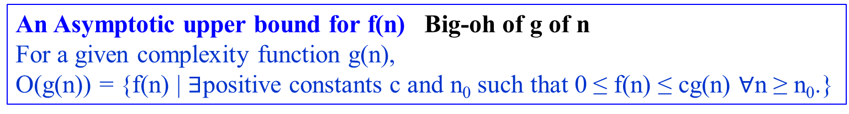
o-notation
The asymptotic upper bound provided by O-notation may or may not be asymptotically tight.
For example, The bound 2n² = O(n²) is asymptotically tight, but
the bound 2n = O(n²) is not.
Use o-notation to denote an upper bound that is not asymptotically tight.
Definition: little-oh of g of n
o(g(n)) = { f(n) | for any positive constant c > 0, there exists a constant
n₀ > 0 such that 0 ≤ f(n) < cg(n), for all n ≥ n₀.}
An Asymptotic upper bound for f(n) Big-oh of g of n
For a given complexity function g(n),
O(g(n)) = {f(n) | $∃$positive constants c and n₀ such that 0 ≤ f(n) ≤ cg(n) $∀$n ≥ n₀.}

Slide 38
Example 1.14:
Show that 2n = o(n²) but 2n² ≠ o(n²)
Proof of 2n² ≠ o(n²):
Assume that 2n² = o(n²). That means,
for any positive constant c > 0, there exists a constant n₀ > 0
such that 0 ≤ 2n² < cn² for all n ≥ n₀.
However, if c = 1, that 2n² < n² for all n ≥ n₀ is no longer valid.

Slide 39
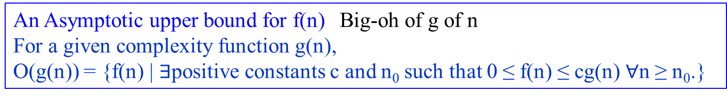
ω-notation
Use it to denote a lower bound that is not asymptotically tight.
Definition: little-omega of g of n
ω(g(n)) = { f(n) | for any positive constant c > 0, there exists a
constant n₀ > 0 such that 0 ≤ cg(n) < f(n), for all
n ≥ n₀.}
Another way to define it is by
f(n)ε ω(g(n)) if and only if g(n) ε o(f(n)).
An Asymptotic upper bound for f(n) Big-oh of g of n
For a given complexity function g(n),
O(g(n)) = {f(n) | $∃$positive constants c and n₀ such that 0 ≤ f(n) ≤ cg(n) $∀$n ≥ n₀.}

Slide 40
Background:
Standards, Notations,
and Common Functions

